Slide 1
V.A.V.S.
What is it?

Slide 2
Veterans Affairs Voluntary Services
The Department of Veterans Affairs Voluntary Service (VAVS) was founded in 1946 to provide for our nation's veterans while they are cared for by VA health care facilities. It is the largest centralized volunteer program in the Federal government with over 350 organizations supporting VAVS, including the Knights of Columbus. VAVS volunteers have donated 508 million hours of service since 1946.

Slide 3
“Serving Those Who Served” An Invitation to Service
The V.A. is grateful for the wonderful response to help America's heroes. Many thanks for volunteering to serve those who served.

Slide 4
4th Degree Knights of Columbus
WHAT IS OUR MISSION?

Slide 5
Charity Unity Fraternity
PATRIOTISM

Slide 6
Questions to Ponder - -
Do your Assemblies have a VAVS person?
2. Do your Assemblies conduct Patriotic programs throughout the year?
3. Do you know where all the V.A. facilities are in your District?
4. Do you have a District-Wide Patriotic Program?

Slide 7
OUR MILITARY WARRIORS ARE THE GATEKEEPERS OF OUR FREEDOM

Slide 8
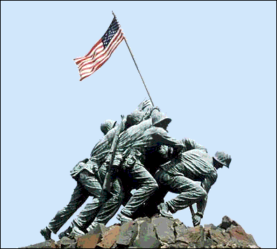
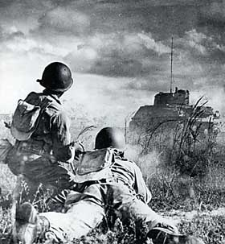
Gatekeepers of
OUR
FREEDOM

Slide 9
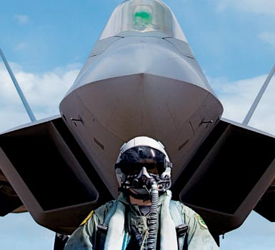
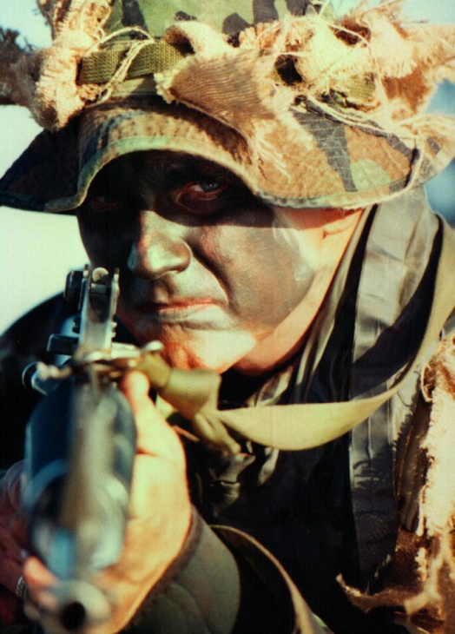
Gatekeepers of
OUR
FREEDOM

Slide 10
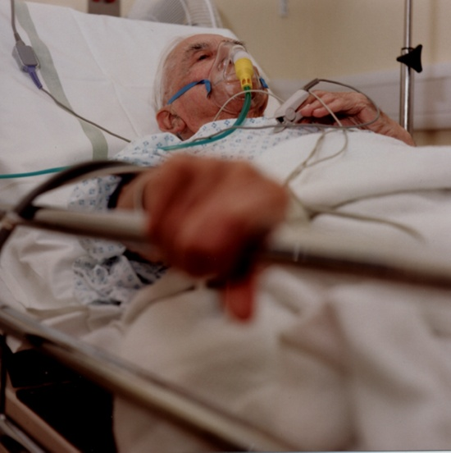
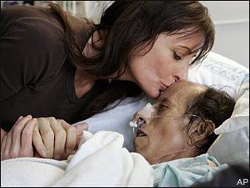
There is a SEASON
For ALL Things!
A Time To LIVE
A Time to Die
Do We
OWE THEM
ANYTHING NOW?

Slide 11
LET US HONOR OUR MILITARY VETERANS

Slide 12
V.A.V.S.
Individual Assembly projects and programs are GREAT!

Slide 13
V.A.V.S.
BUT………….
CAN WE DO BETTER?

Slide 14
Strength Comes From Numbers!
If we lock arms together
We can accomplish more
Than we can ever accomplish separately!

Slide 15
JOINED TOGETHER WE CAN ACCOMPLISH GREAT THINGS

Slide 16
A Program from Michigan District II
“OPERATION”
“PATRIOTISM”

Slide 17
Presented to the District leadership & membership at a district meeting for their consideration as a new District program in 2009.
Unanimously accepted by everyone present!
Specifics:
Each Assembly contributes $250.00 per Calendar year towards Operation Patriotism.
The District chooses one annual project from proposals of the Assemblies.
The annual projects are rotated throughout the District.

Slide 18
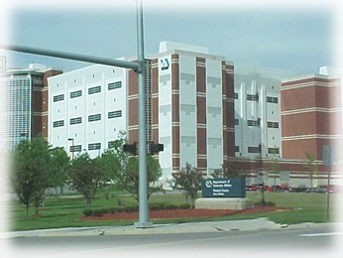
1st Operation Patriotism Project
V.A. HOSPITAL
ANN ARBOR, MICHIGAN

Slide 19
“A PALLIATIVE ROOM” “A HOSPICE CARE ROOM” “A PLACE TO SAY GOOD-BYE” “A PLACE TO PREPARE”

Slide 20
The Ann Arbor Hospital was in the process of renovating it’s Palliative Rooms However they ONLY did them as DONATIONS would allow

Slide 21
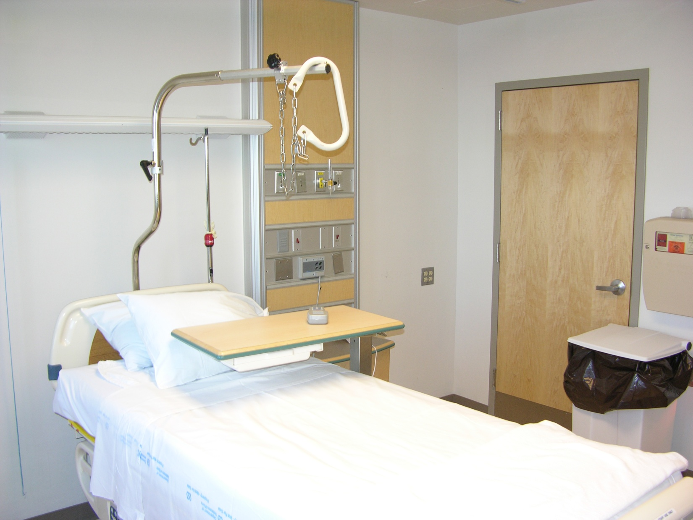
A ROOM BEFORE RENOVATION

Slide 22
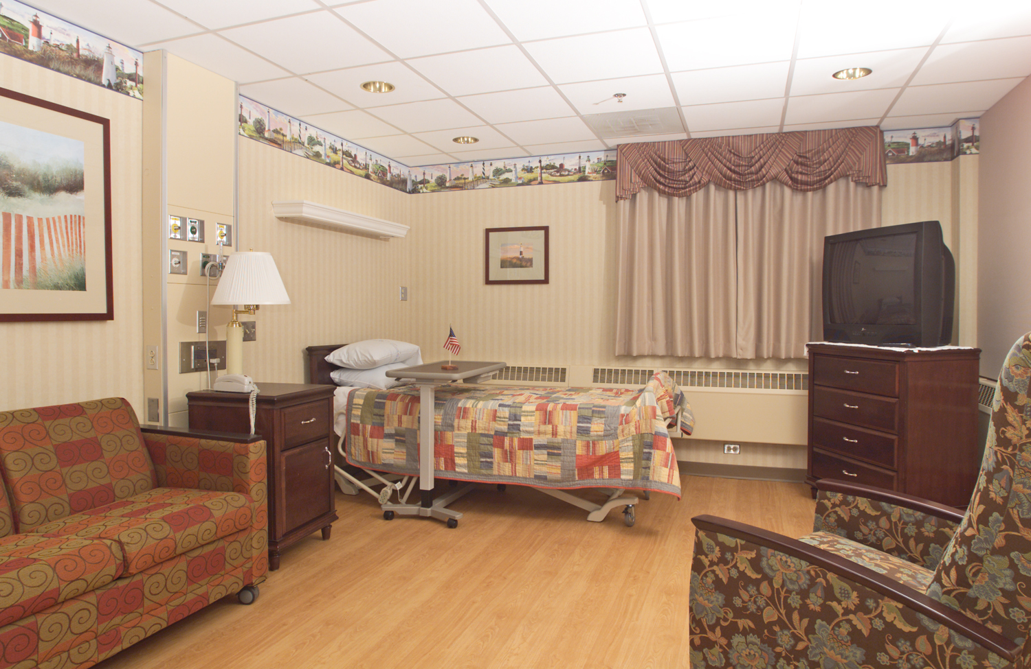
A ROOM AFTER RENOVATION

Slide 23
OPERATION PATRIOTISM
Typical cost to renovate a Palliative room is:
$7,000.00

Slide 24
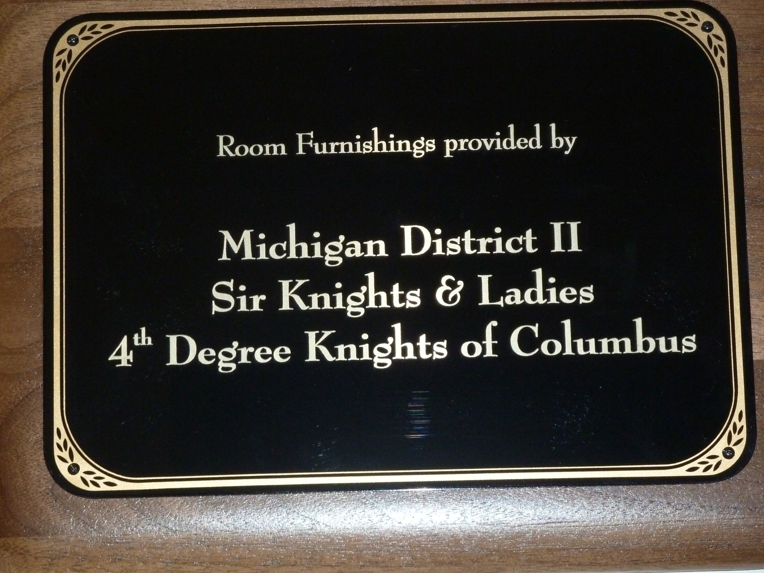
OPERATION PATRIOTISM

Slide 25
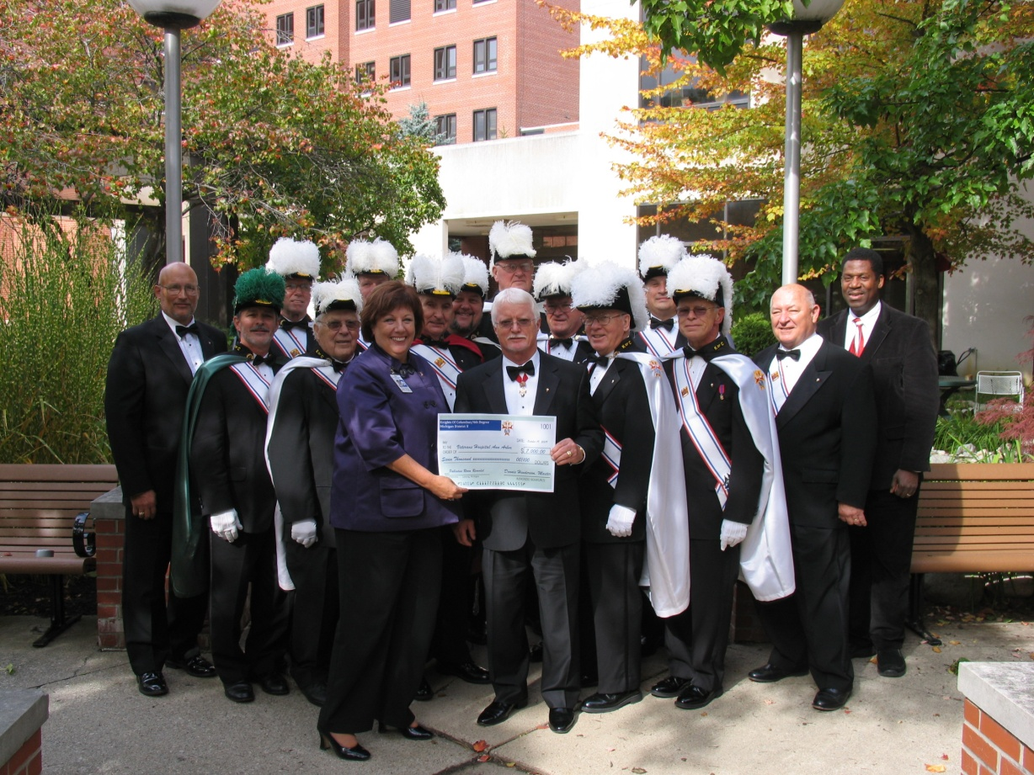
$7,000.00 Check Presented For the New Knights of Columbus Palliative Care Room
MISSION ACCOMPLISHED

Slide 26
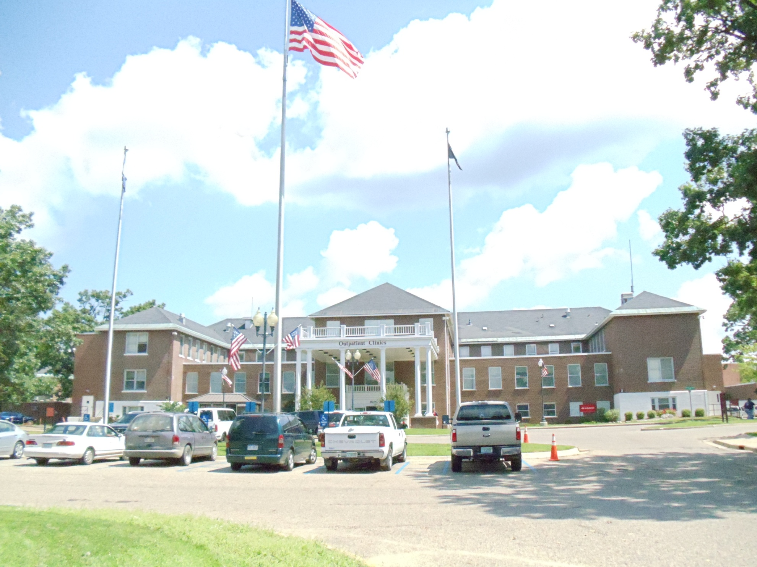
2nd Operation Patriotism Project
The Battle Creek VA facility with 206 acres

Slide 27
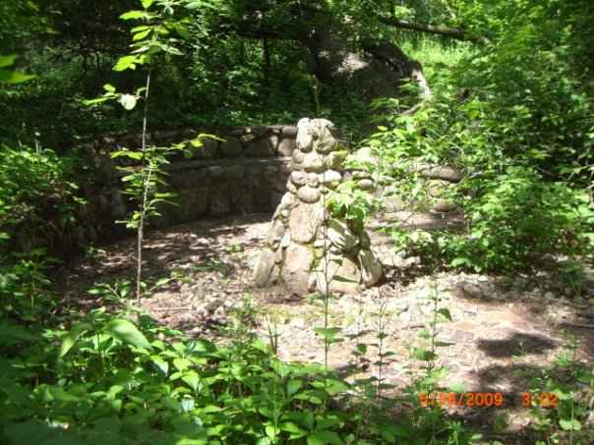
A GREAT NEW IDEA---
RESTORE & INSTALL
AN HISTORIC PATRIOT
FOUNTAIN & REFLECTING POOL

Slide 28
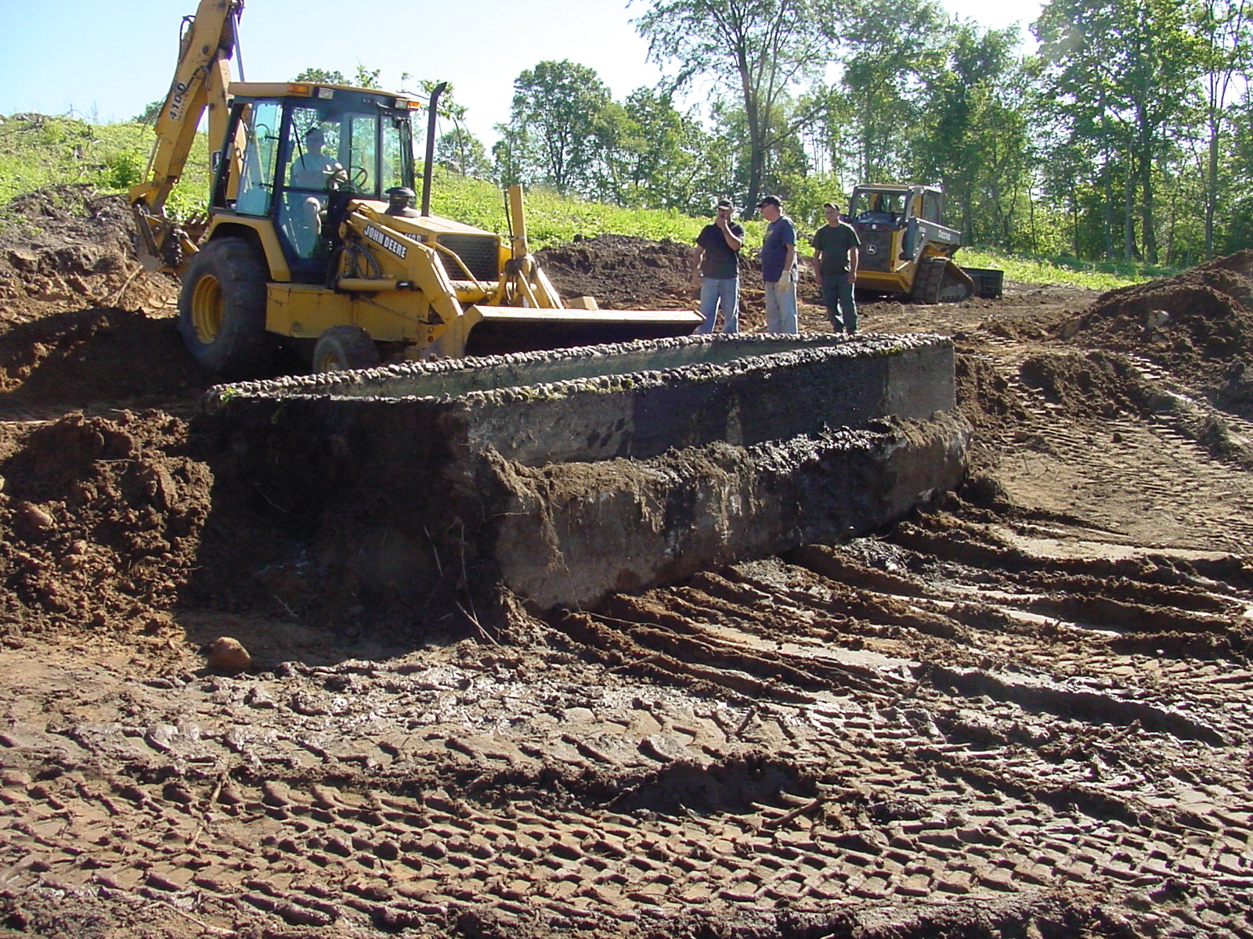

Slide 29
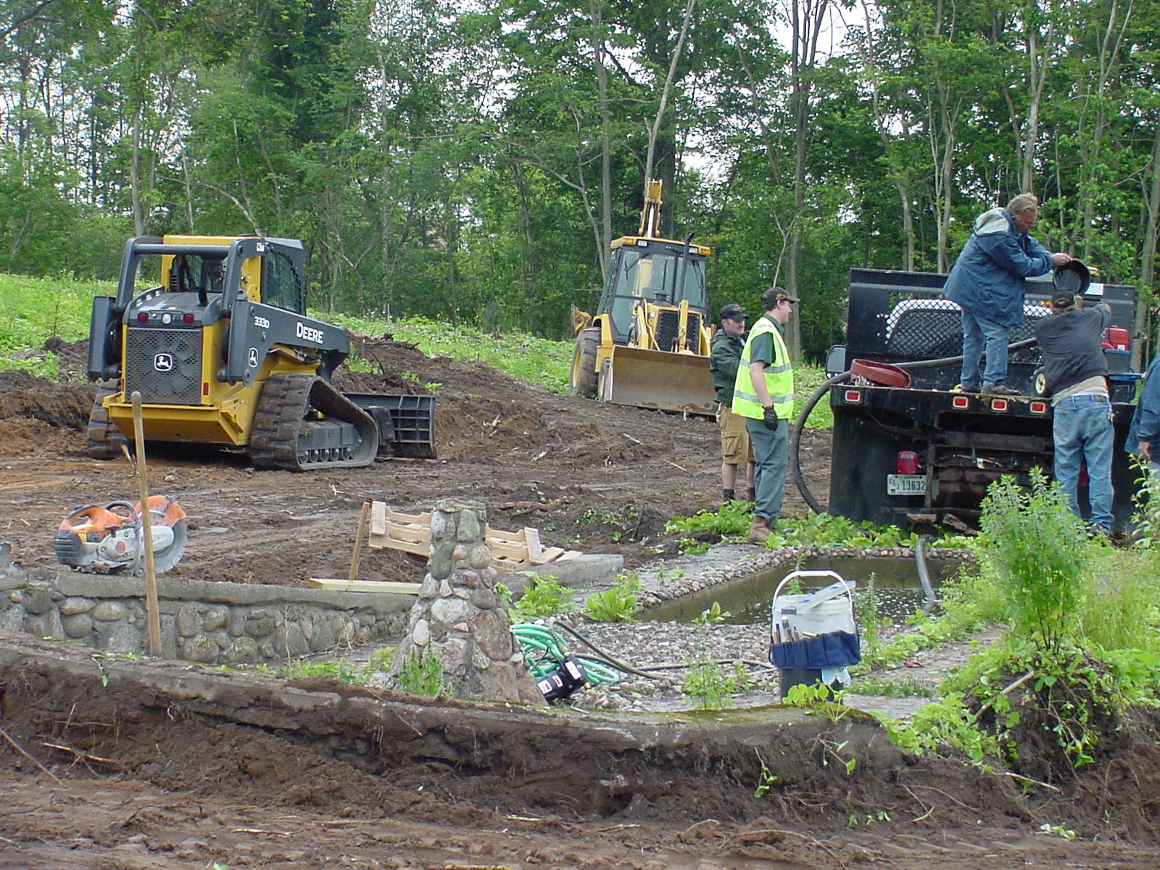

Slide 30
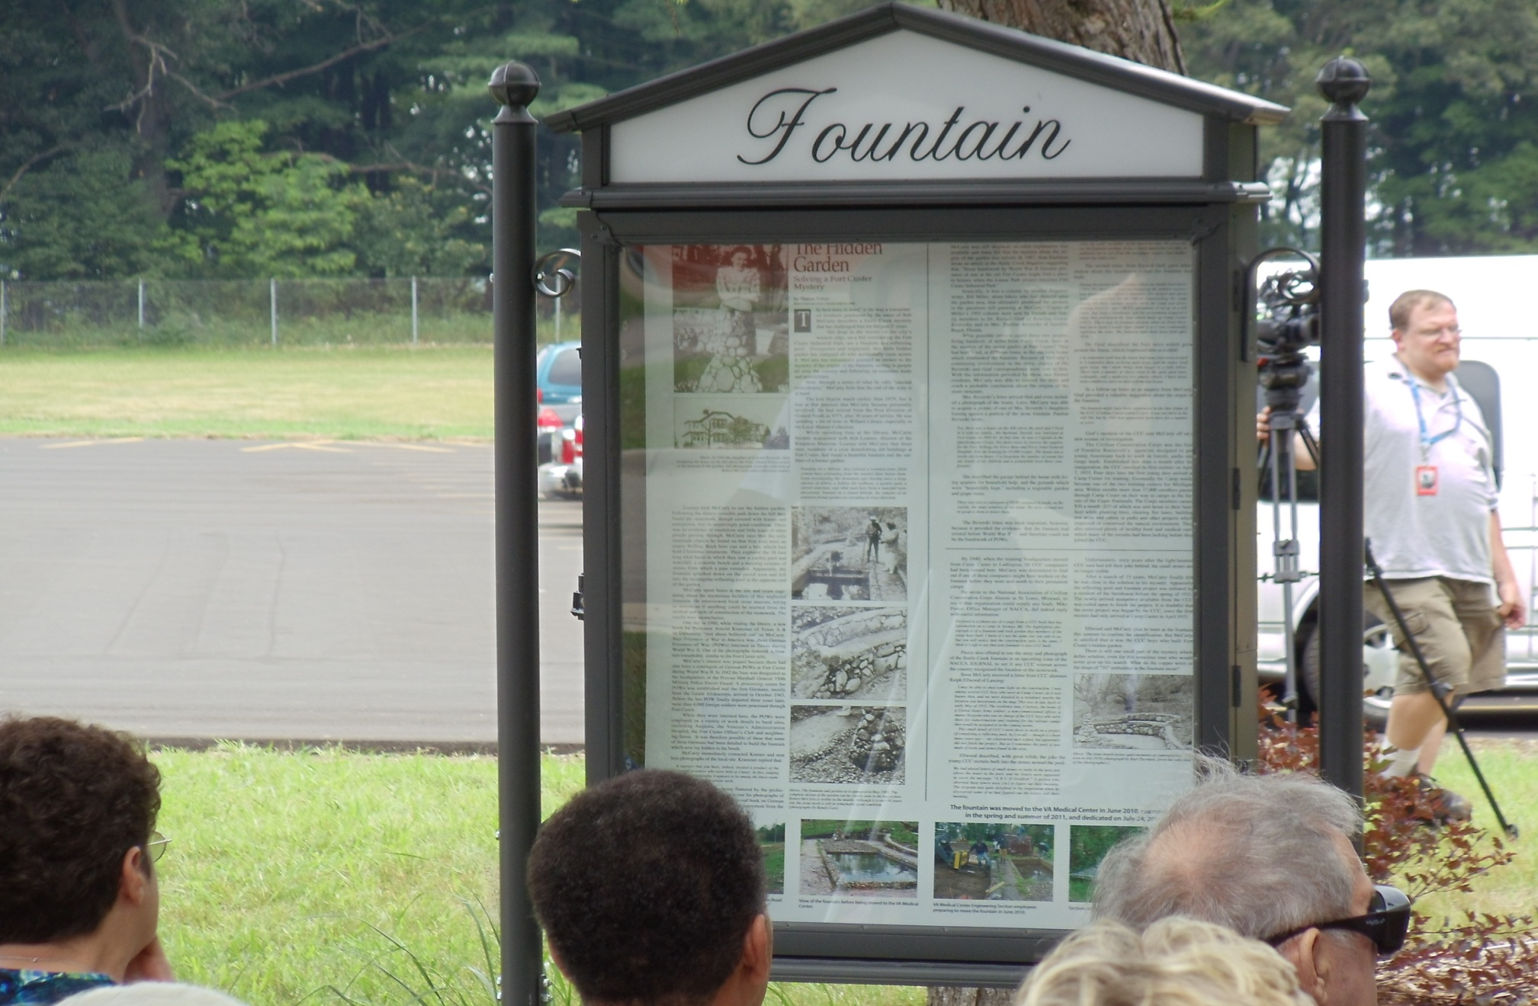

Slide 31
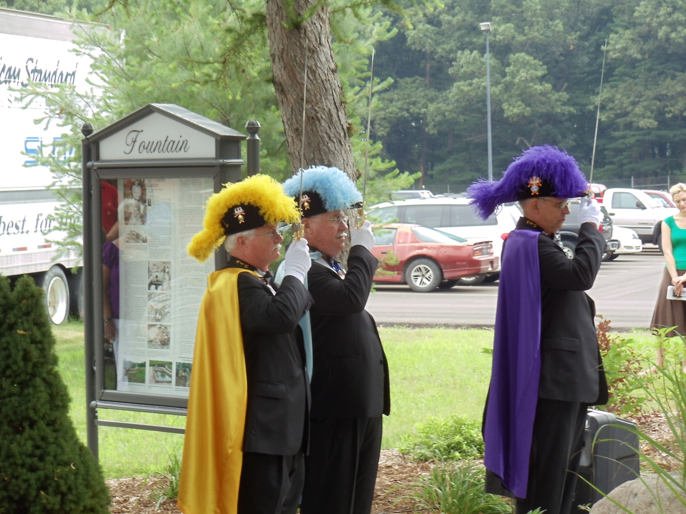

Slide 32
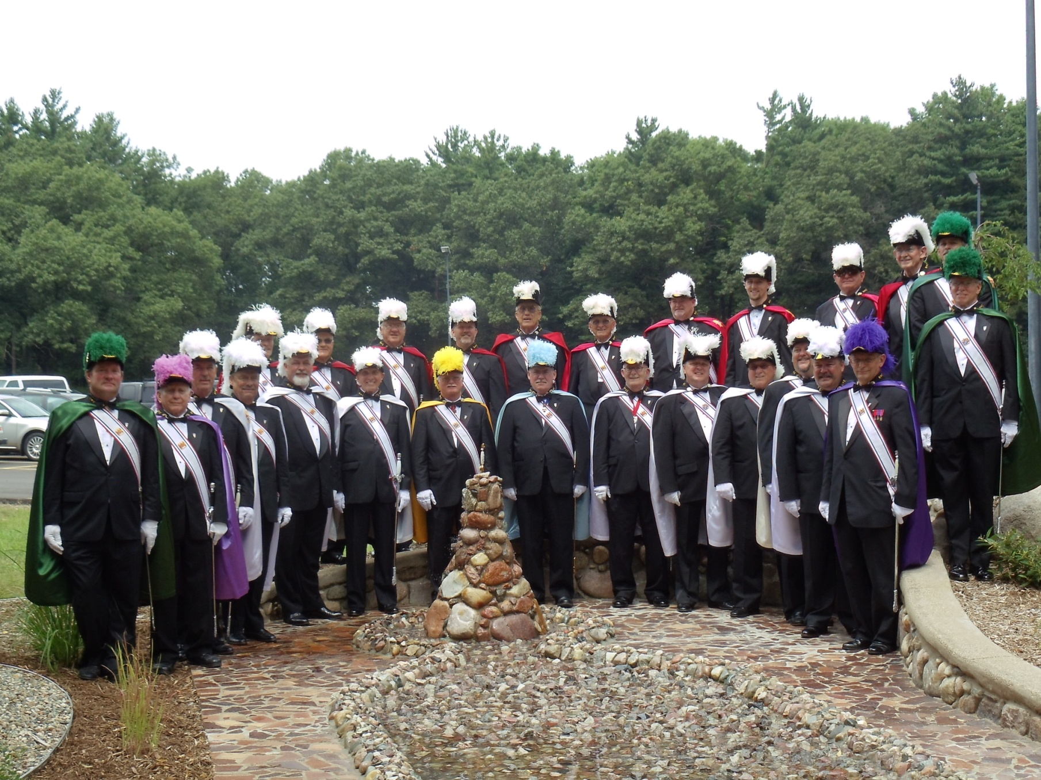

Slide 33
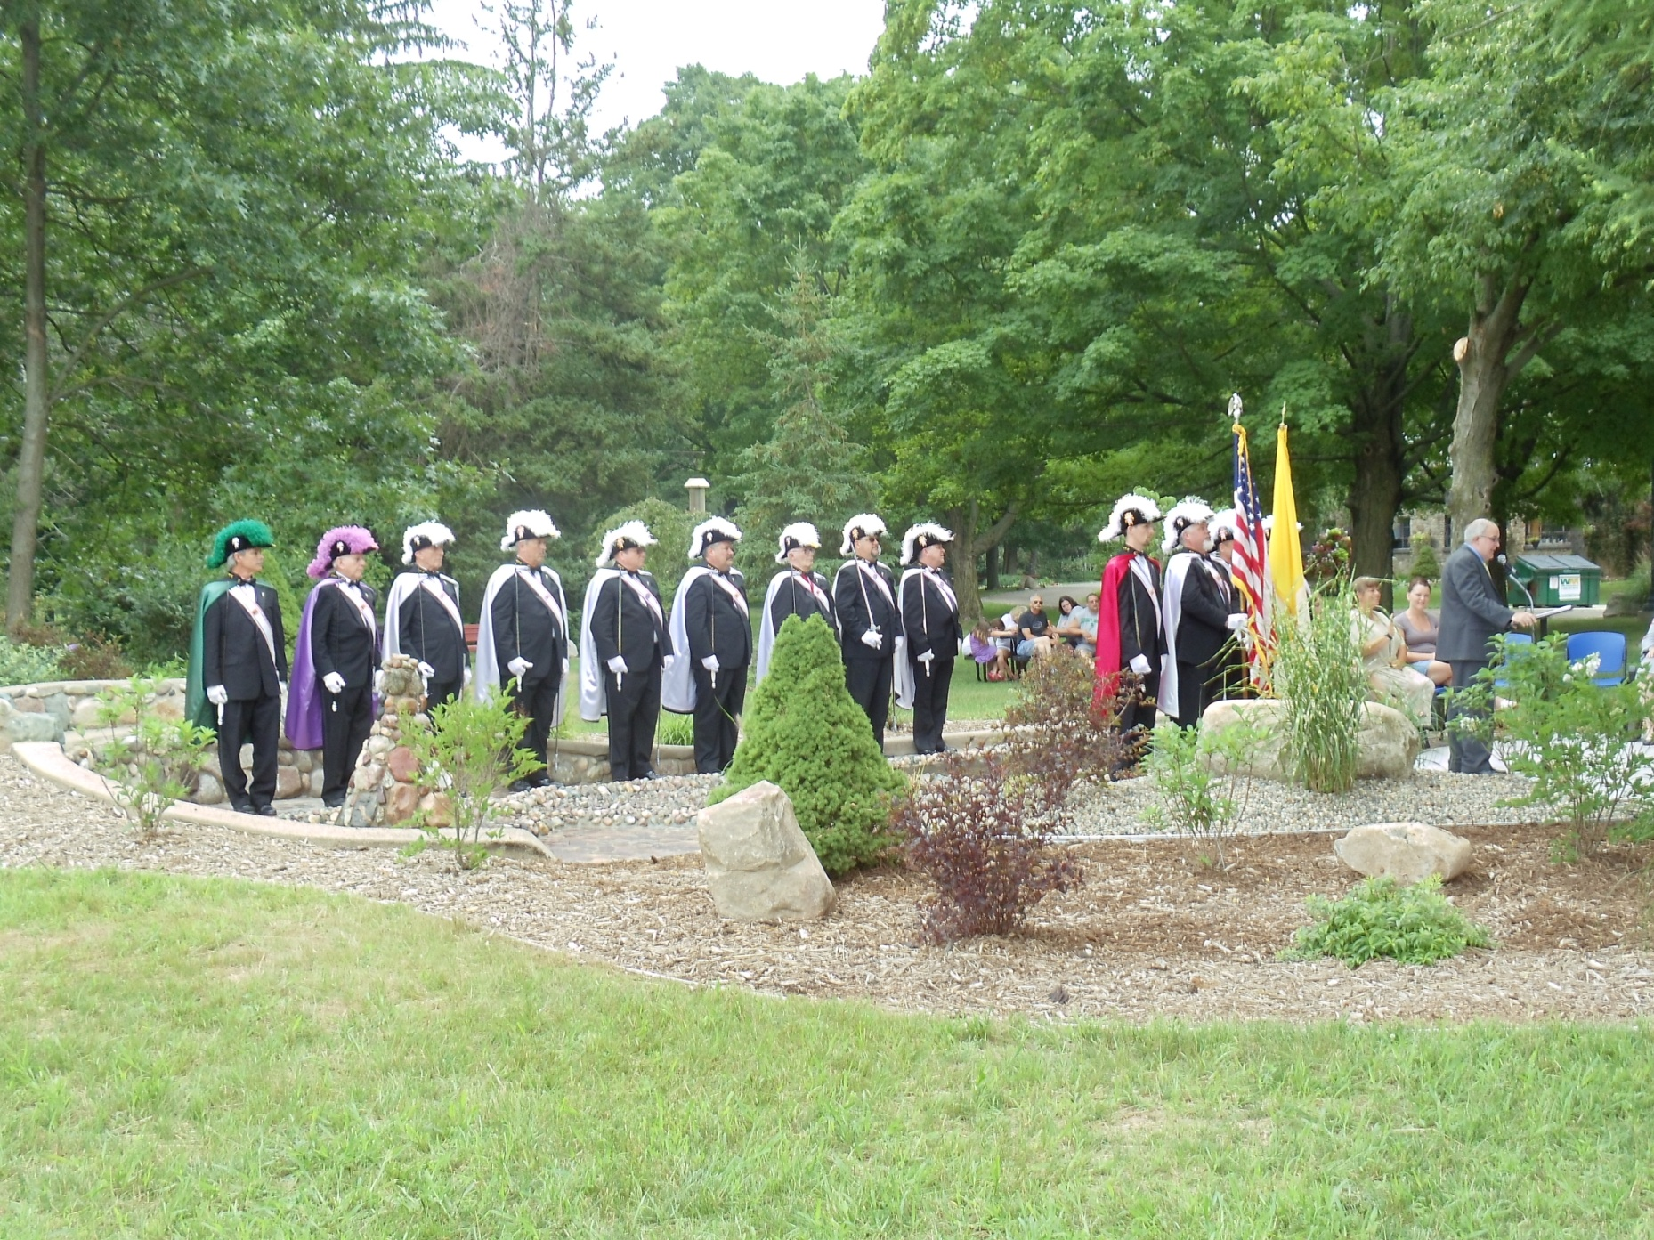

Slide 35
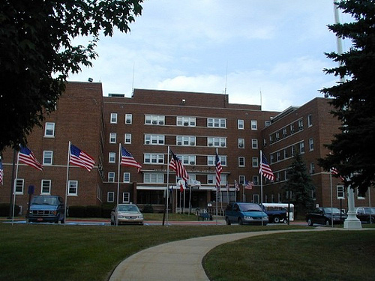
3rd Operation Patriotism Project
Aleda E. Lutz V.A. Facility
Saginaw, Michigan

Slide 36
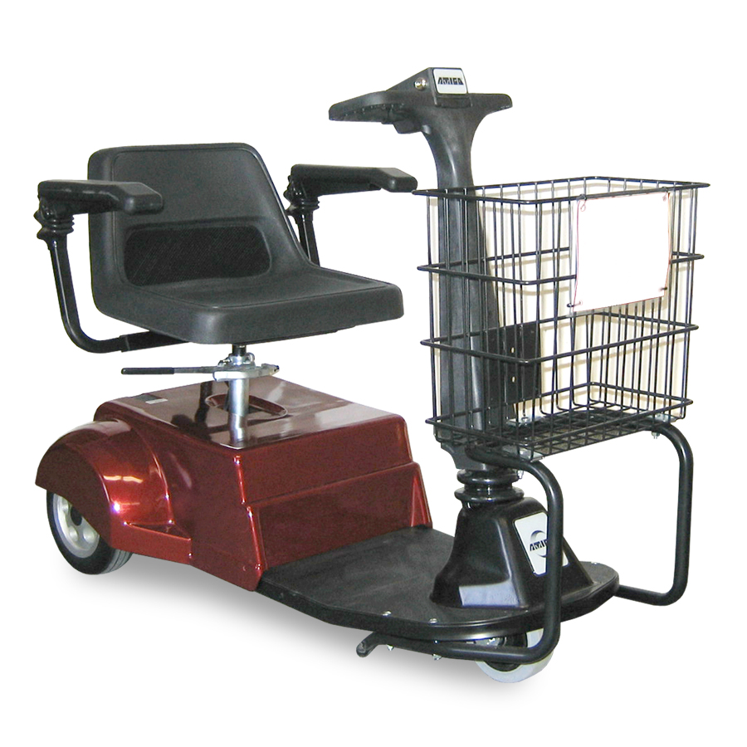
A Severe Need For
On-Site Transportation
An American made “Amigo”
The very best in the world - - Made in Bridgeport, MI.

Slide 37
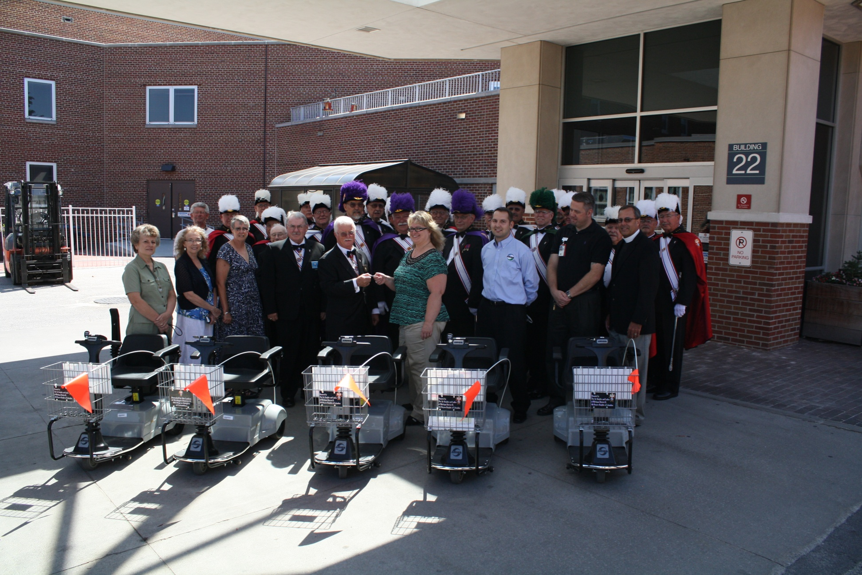
FIVE NEW “AMERICAN MADE” AMIGOS

Slide 38
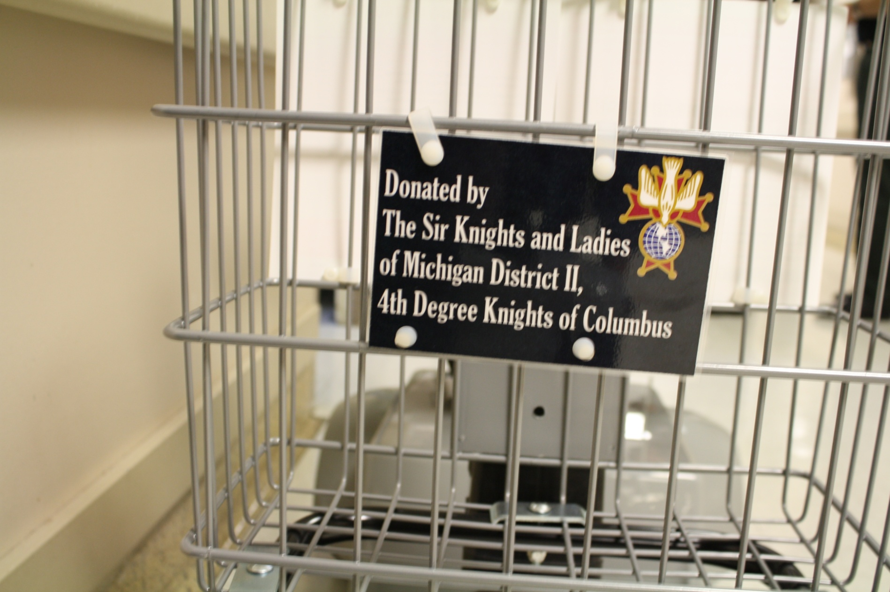

Slide 39
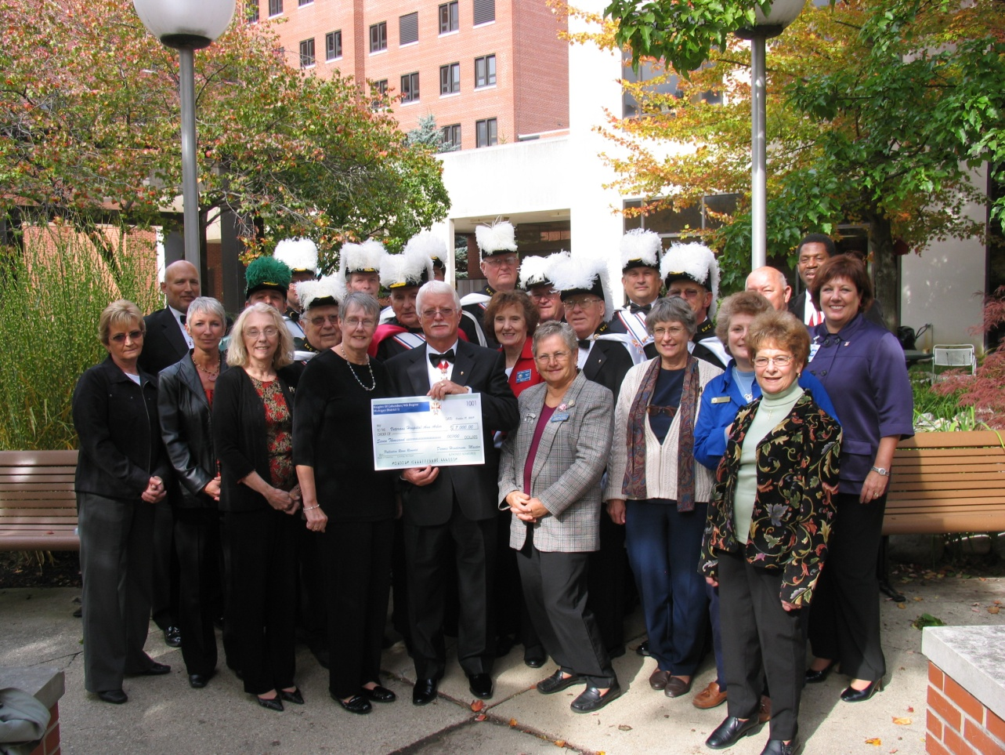
Our lovely ladies have been involved since the beginning. They have donated over $1,000.00 to Operation Patriotism EVERY YEAR!

Slide 40
Is it possible
To duplicate this
Program throughout
The Province?

Slide 41
Can you create a
Consensus
In your
District?

Slide 42
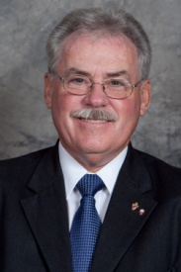
The Vice Supreme Master
Stands Ready To Support
Your Efforts
&
To Recognize This
As a Provincial Program.

Slide 43
The Choice is Yours!
YOU CAN MAKE IT HAPPEN!
YOU CAN MAKE A DIFFERENCE IN OUR VETERAN’S LIVES !

Slide 45
THANK
YOU

